Slide 1
Module 10:
Transactions in MS SQL

Slide 2
Objectives
At the end of the session, you will learn:
Transactions in SQL Server
Modes of Transactions
Explain Explicit Transactions

Slide 3
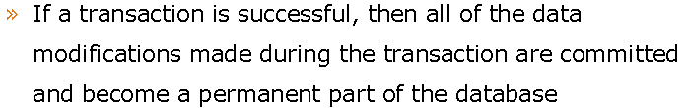

Overview of Transaction

Slide 4
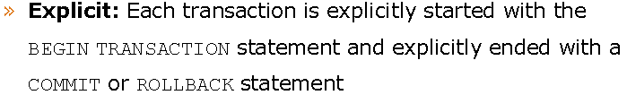
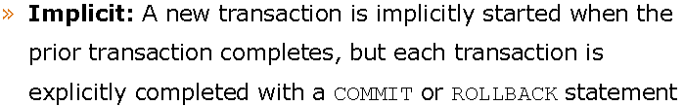
Modes of Transaction

Slide 5
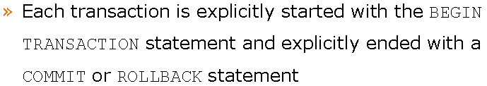
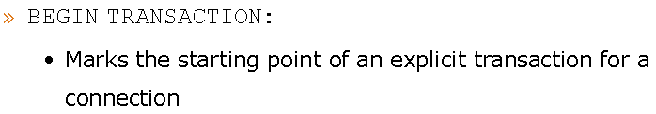
Explicit Transaction

Slide 6
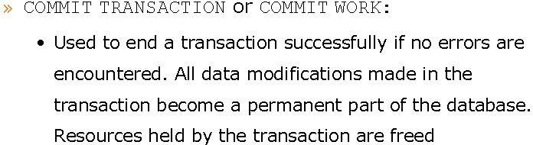
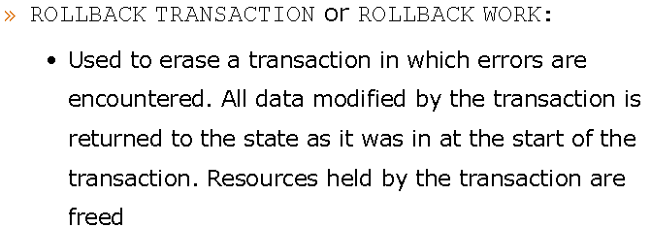
Explicit Transaction (contd.)

Slide 7
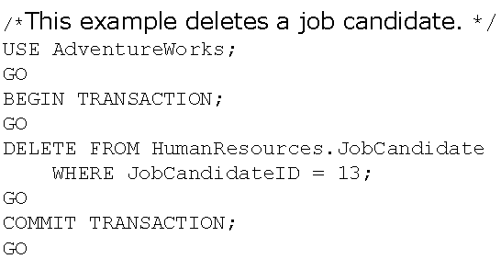
Explicit Transaction (contd.)

Slide 8
Thank You…!

